Slide 1

UNIFIED MENTOR INTERNSHIP
Project -2 : Pizza Sales Dashboard Analysis
Name - SHASHANK BAJPAI
Email – Shashankax0@gmail.com
Designation – Business Analyst Intern

Slide 2
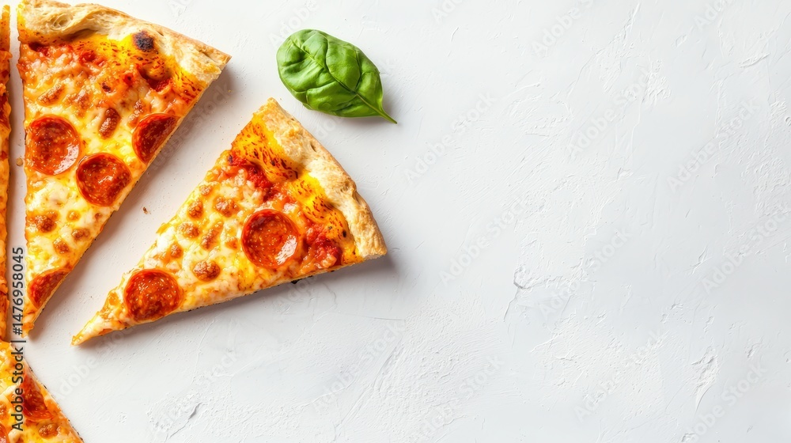
🔷 Project Overview
This project focuses on analyzing historical sales data from a fictional pizza delivery business to identify performance trends, uncover key insights, and drive informed business decisions. The goal was to use data visualization and dashboarding tools to transform raw data into actionable intelligence.
🔍 Objectives
Understand customer preferences by analyzing sales across pizza sizes, categories, and ingredients.
Identify top-performing and underperforming pizzas.
Track overall sales and order trends across time.
Deliver strategic business recommendations based on insights.
Design professional dashboards for stakeholders.

Slide 3
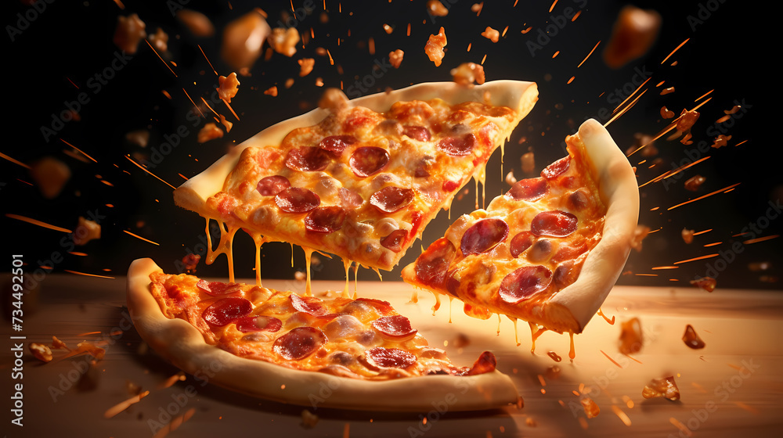
📊 Dashboard Summary
🔹 Excel Dashboards
Built multiple dashboards showing KPIs like total orders, total revenue, and average order value.
Visualized monthly sales, weekday trends, and hourly demand patterns.
Highlighted top and bottom-selling pizzas with dynamic visuals.
🔹 Tableau Dashboards
Created interactive dashboards showing:
Sales breakdown by category, size, and ingredient.
KPI tracker for revenue, pizzas sold, and order volumes.
Visual comparison of top 5 and bottom 5 pizzas.

Slide 4
✅ Key Insights from the Pizza Sales Analysis
📊 Sales Performance Overview
Total Orders: 21,350
Total Units Sold: 49,574
Total Revenue: ₹817,860
Average Order Value: ₹38.31
📆 Sales by Weekday
Sales are evenly distributed across all weekdays.
Sunday and Wednesday slightly outperform others in total revenue.
Insight: No major dip on weekdays; consistent customer flow throughout the week.

Slide 5
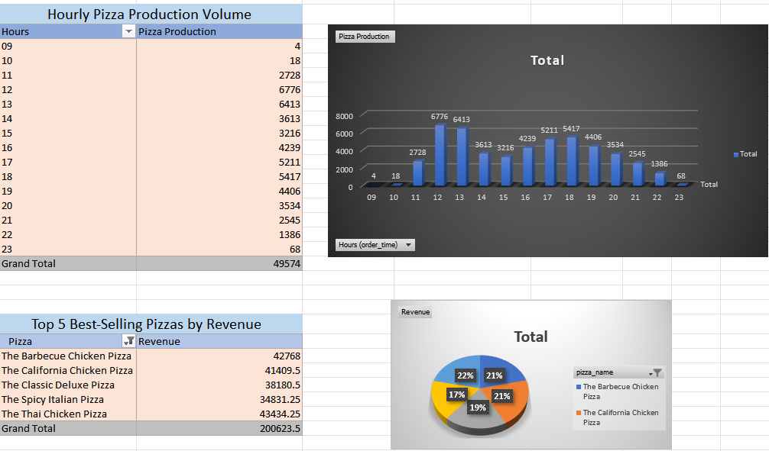

Slide 6
🔍 Key Insights
Peak Hours: Highest orders between 12–2 PM & 5–8 PM (Lunch & Dinner).
Low Demand: Early morning & late night (before 11 AM, after 9 PM).
Top 5 Pizzas by Revenue:
Barbecue Chicken, California Chicken, and Classic Deluxe lead sales.
Chicken-based pizzas dominate customer preference.
🚀 Suggestions for Growth
Time-Based Offers: Launch Lunch/Dinner Combos & Happy Hour Deals (3–5 PM, 9–10 PM).
Focus on Best-Sellers: Promote top chicken pizzas in campaigns and combo deals.
Operational Efficiency: Reduce prep and staff during off-peak hours.
Promote Fan Favorites: Highlight Spicy Italian & Thai Chicken in seasonal promos.

Slide 7
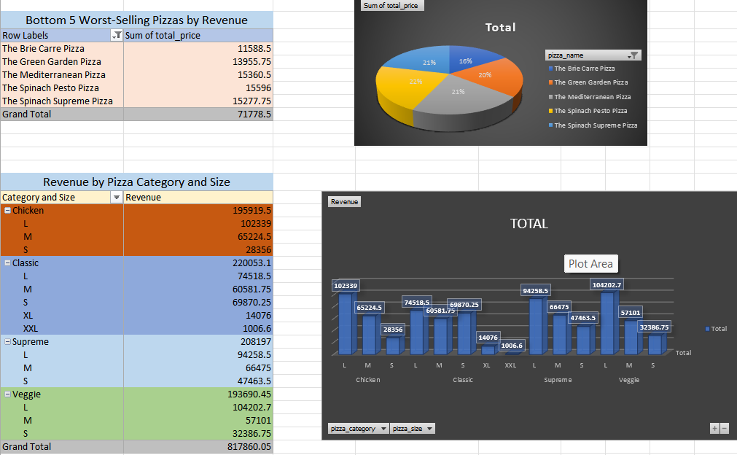

Slide 8
Peak Hours: Highest production at 12 PM (6776) & 1 PM (6413); strong activity from 5–8 PM.
Low Hours: Very few orders between 9–10 AM & 9 PM onwards.
Top Pizzas by Revenue:
Barbecue Chicken (21%)
California Chicken (21%)
Classic Deluxe, Spicy Italian, Thai Chicken follow closely.
Chicken pizzas dominate top 5 in revenue.
🚀 Growth Suggestions
Run lunch (12–2 PM) & dinner (5–8 PM) meal offers.
Use “Happy Hour” discounts (3–5 PM, 9–10 PM) to boost off-peak sales.
Promote best-sellers in combos for upselling.
Align staffing/inventory with peak hours.

Slide 9
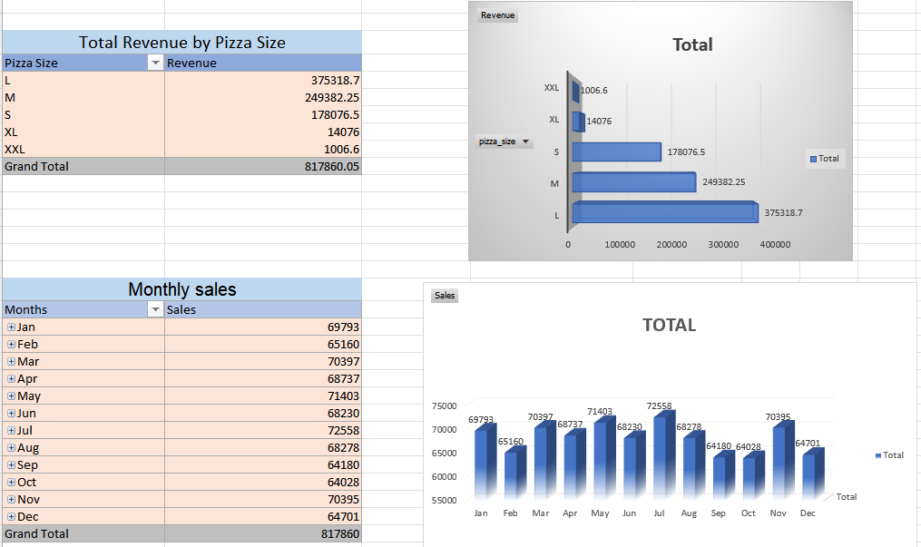

Slide 10
Monthly Sales Trend:
Peak Month: July (₹72,558) – highest monthly revenue.
Lowest Sales: February (₹65,160).
Relatively stable performance in other months (₹68K–₹71K range).
Pizza Size Revenue:
Large (L) pizzas dominate sales (46% of total revenue).
Medium (M) and Small (S) follow.
XL and XXL contribute very minimally to overall revenue.
🚀 Suggestions for Growth
Promote Large size pizzas in combos or loyalty offers (most popular).
Re-evaluate or phase out XXL/XL sizes due to low demand and optimize inventory accordingly.
Launch seasonal promotions during low-sales months (e.g., February, September).
Boost July success by identifying what worked (e.g., offers, events) and replicate.

Slide 11
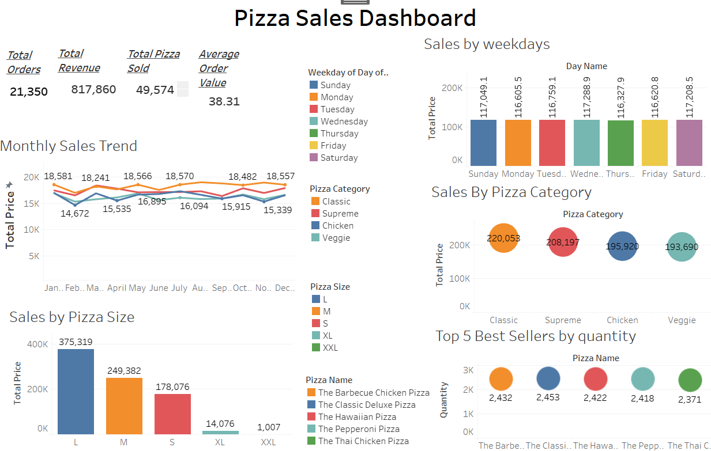

Slide 12
Sales by Pizza Category
Classic pizzas generate the highest revenue (~$220,053)
Followed by Supreme, Chicken, and Veggie
👉 Classic pizzas are the most popular—consider upselling or bundling with sides.
📏 Sales by Pizza Size
Large (L) pizzas dominate with the highest revenue ($375,319)
Medium (M): $249,382
Small (S): $178,076
XL and XXL sizes generate minimal revenue
👉 Focus on promoting L and M sizes, and assess the viability of offering XL and XXL sizes.
⭐ Top 5 Best-Selling Pizzas (by Quantity)
1.The Classic Deluxe Pizza – 2,453 units
The Barbecue Chicken Pizza – 2,432
The Hawaiian Pizza – 2,422
The Pepperoni Pizza – 2,418
The Thai Chicken Pizza – 2,371

Slide 13
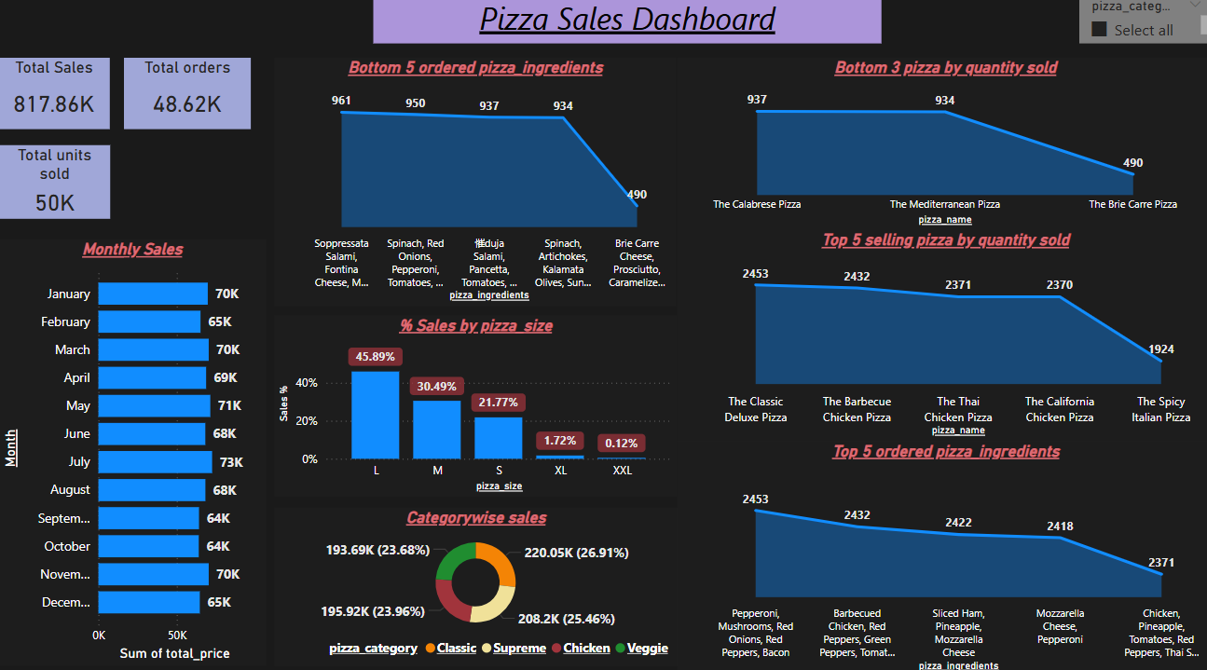

Slide 14
✅ Top 5–6 Major Insights from Pizza Sales Dashboard
Large Pizzas Drive Sales
45.89% of all pizzas sold are Large (L) size, followed by Medium (30.49%).
XL and XXL sizes contribute less than 2%—can be deprioritized to reduce operational overhead.
Balanced Category Preference
Sales are almost evenly split across Classic (27%), Supreme (25%), Chicken (24%), and Veggie (24%) categories.
Indicates a diverse customer base—ideal for offering combo deals that mix categories.
Consistent Monthly Performance
Sales remain relatively stable across all months, peaking in July (~73K).
Shows steady demand and potential for reliable forecasting and resource planning.

Slide 15
Top-Selling Pizzas
Best sellers by quantity are:
The Classic Deluxe Pizza (2,453 units)
The Barbecue Chicken Pizza (2,432)
The Thai Chicken Pizza (2,371)
These should be featured prominently in promotions and combos.
Ingredient Optimization Opportunities
Top ingredients (e.g., Pepperoni, Mozzarella, Red Peppers) are consistently used in best sellers.
Bottom ingredients (e.g., Soppressata Salami, Brie Cheese) show low demand—consider revising menu or phasing out.
Underperforming Products Need Review
Brie Carre Pizza, Mediterranean Pizza, and Calabrese Pizza are the lowest selling.
Suggest rebranding, limited offers, or removal to streamline the menu.

Slide 16
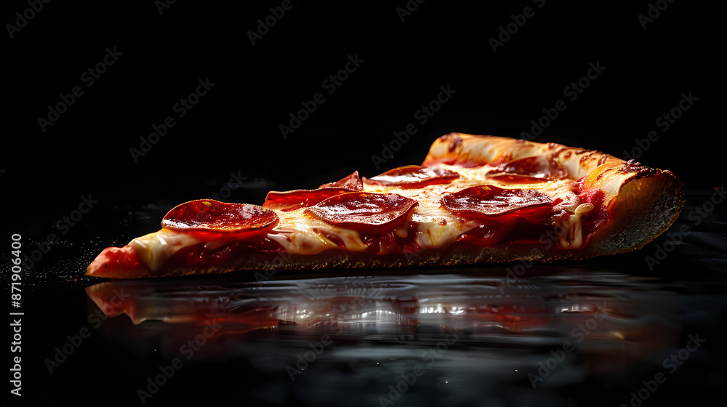
Thank you for the opportunity.
Open to questions or further analysis.

